Slide 1
Arabic Sign Language Detection
Using MediaPipe & Keras

Slide 2
Project Objective
- Detect and classify Arabic sign language letters in real-time.
1
- Use computer vision (MediaPipe) and deep learning (Keras).
2
- Provide accurate predictions for 30 Arabic letters.
3

Slide 3
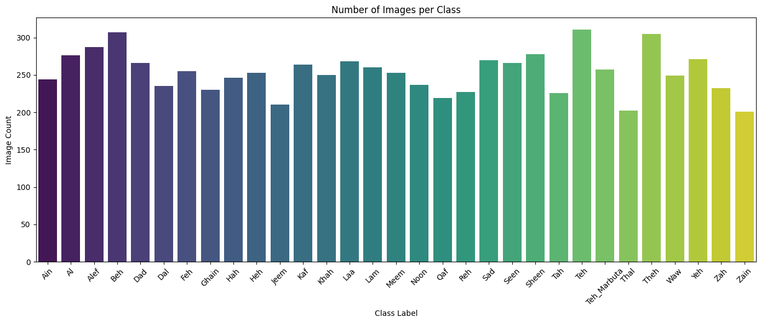
Dataset Overview
- Images of hand gestures for each Arabic letter.
- Preprocessed to size (200x200), normalized.
- Labels encoded using LabelEncoder.

Slide 4
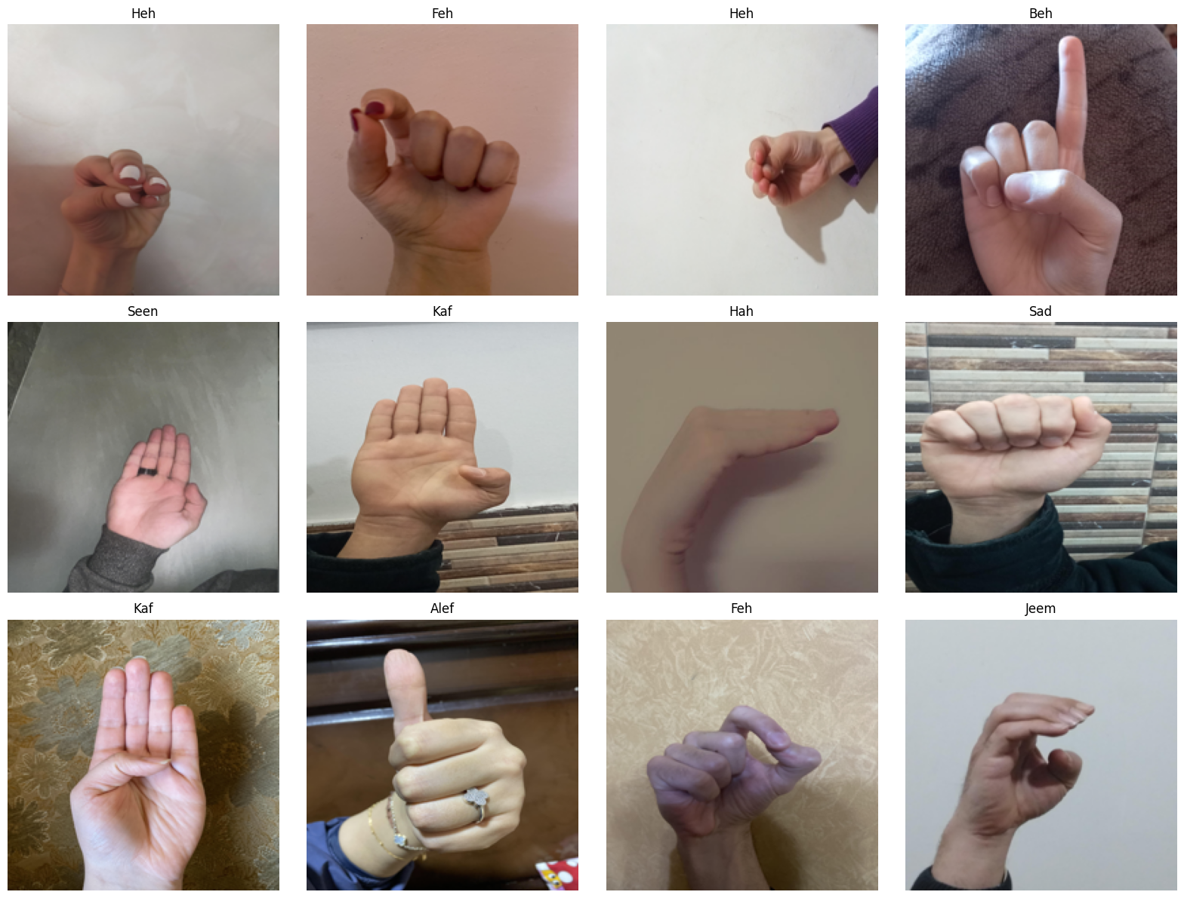
data

Slide 5
Model Architecture
- Base Model: VGG19 (last 4 layers trainable).
- Layers added: GlobalAvgPool -> Dense(512) -> Dropout -> Dense(256) -> Output.
- Loss: sparse_categorical_crossentropy | Optimizer: Adam

Slide 6
Training & Validation Results
- High training accuracy (~99%).
- Validation accuracy ~87%.
- Some overfitting noticed, can be improved with data augmentation.

Slide 7
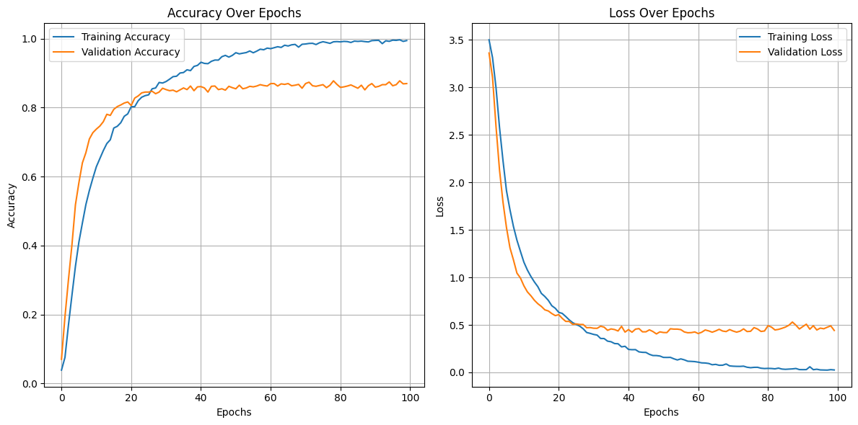

Slide 8
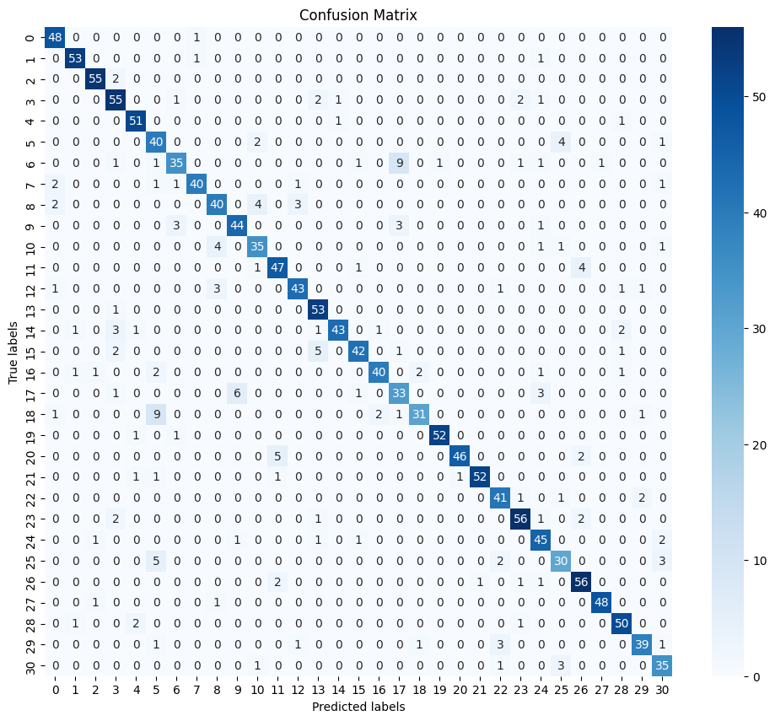

Slide 9
Real-Time Detection
- MediaPipe used to track hands and crop hand region.
- Frame processed and passed to model for prediction.
- Output shown live with label and confidence score.

Slide 10
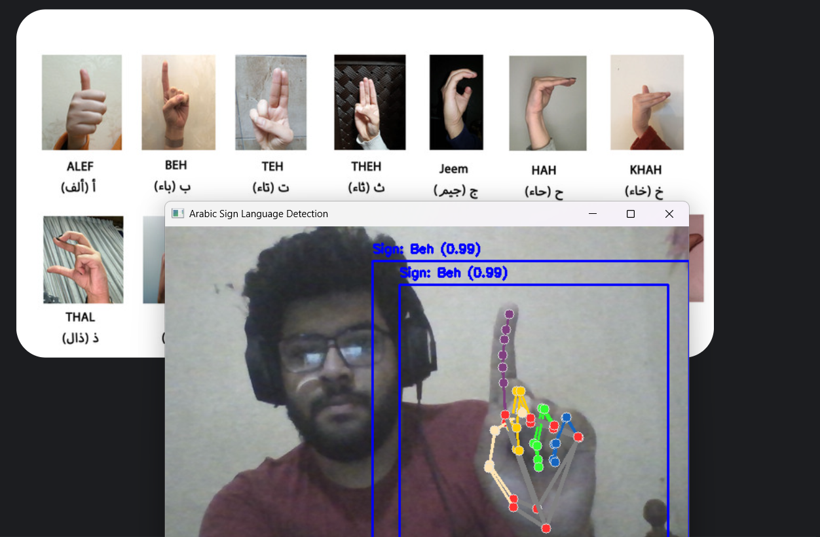
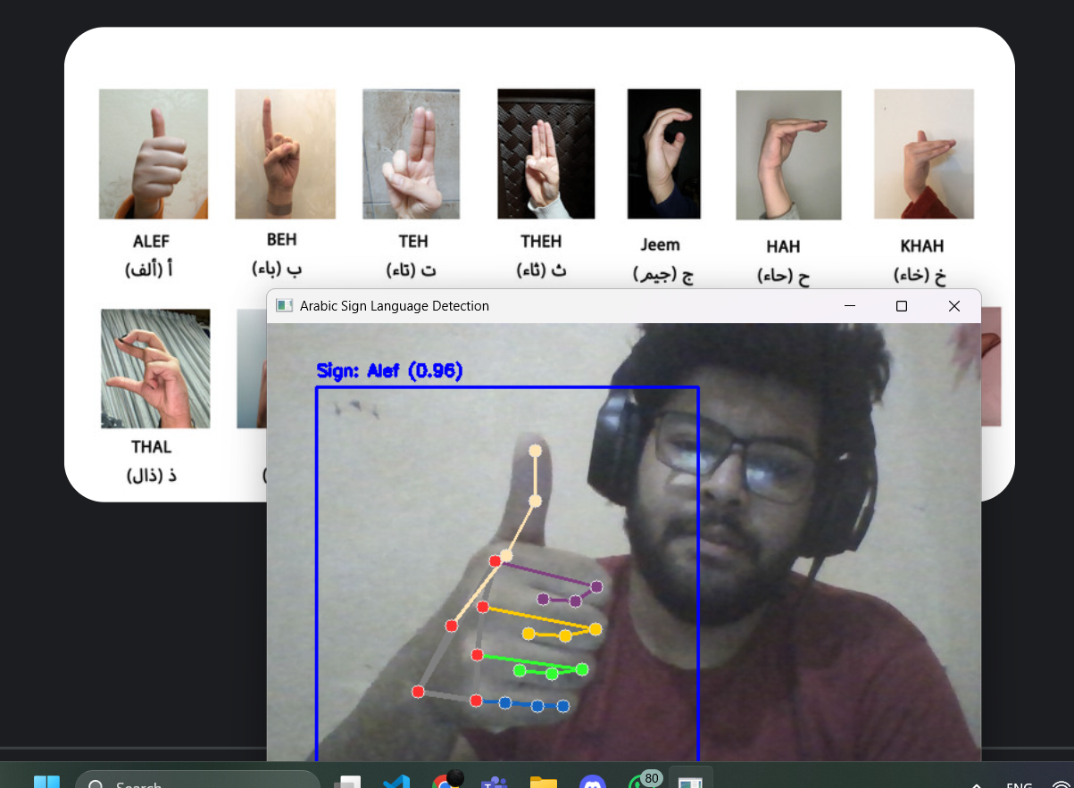
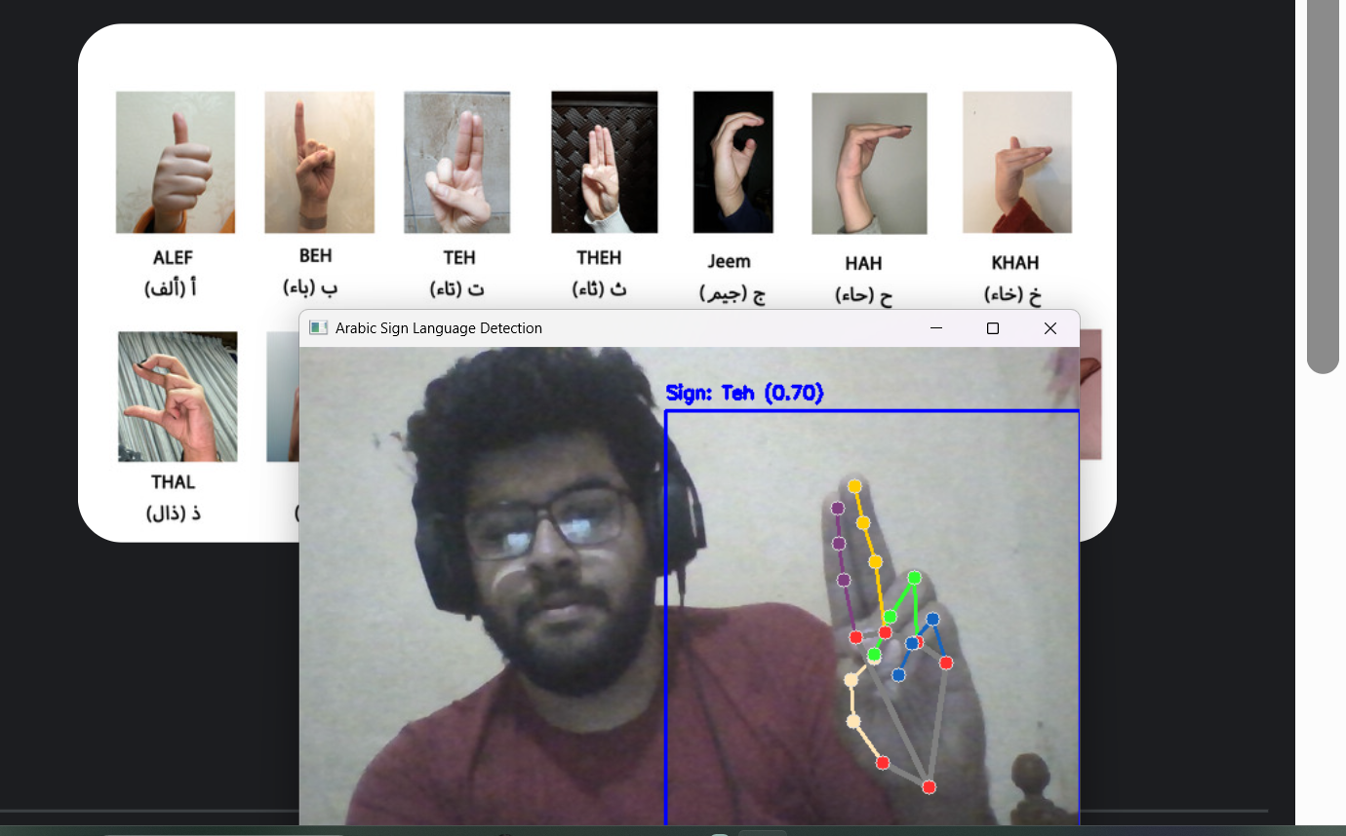

Slide 11
Future Improvements
Add
- Add sequence models (LSTM) for full word detection.
Include
- Include multi-hand interaction.
Improve
- Improve dataset diversity and lighting conditions.

Slide 12

Thank You
Questions?

